Slide 2
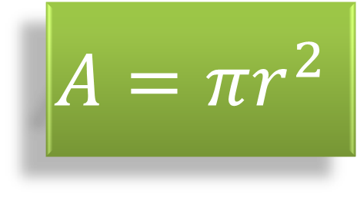
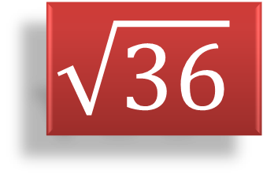
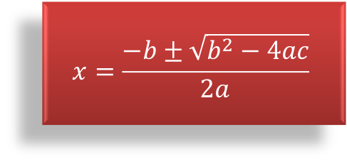
x²
?
?
$$\sqrt{36}$$
$$x=\frac{−b±\sqrt{b^{2}−4ac}}{2a}$$
$$A=πr^{2}$$

Slide 3
x
4
10

Slide 4
10
x
4

Slide 5
10
4
x
4

Slide 6
x
6

Slide 7
10
x
4
10
6

Slide 8
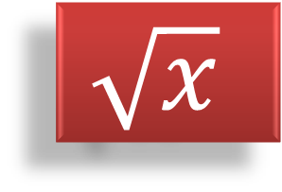
+
-
.
/
x²
$$\sqrt{x}$$

Slide 9
x
10
=
2
+
4
+
x
20
-10
-10

Slide 10
x
=
x
4
2
+
10
-2x
-2x

Slide 11
.
x
=
2
10
2
2

Slide 12
x
=
5

Slide 13
30
30
4
x
10
=
2
+
20
+
x
20
.5
10
.5

Slide 14
a²
+
16
=
25
-16
-16

Slide 15
√
a²
√
=
9

Slide 16
a
=
3

Slide 17
25
a²
+
16
=
25
9
3

