Slide 2
∏

Slide 3
∏=3,14

Slide 5
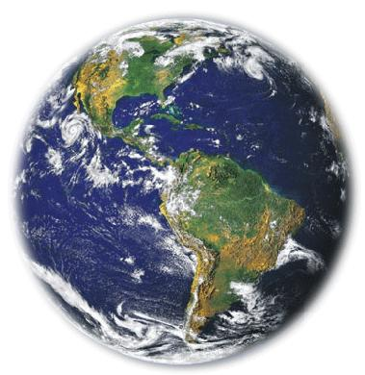
3.14!
40.075km
12.756km

Slide 6
36,7cm!
3.14
12 cm
x

Slide 7
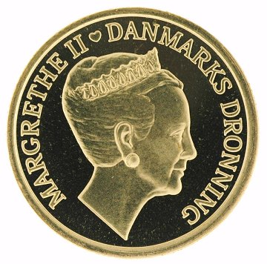
8,48cm
3.14
2,7cm

Slide 8
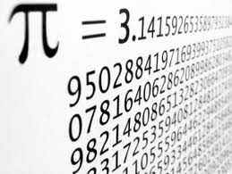
67.890 decimaler!

